Slide 1

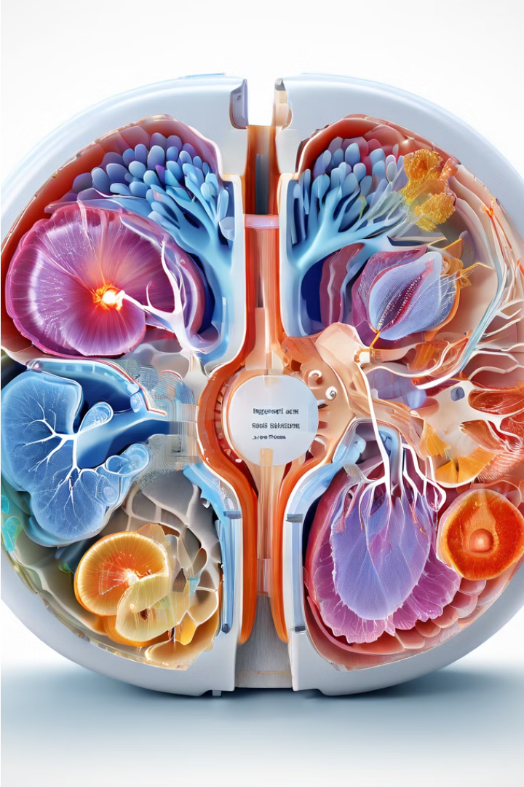
Introduction to Chronic Kidney Disease
Chronic kidney disease (CKD) is a progressive condition where the kidneys gradually lose their ability to filter waste and excess fluids from the body. This can lead to a buildup of harmful substances, potentially resulting in serious health complications if left untreated.

Slide 2
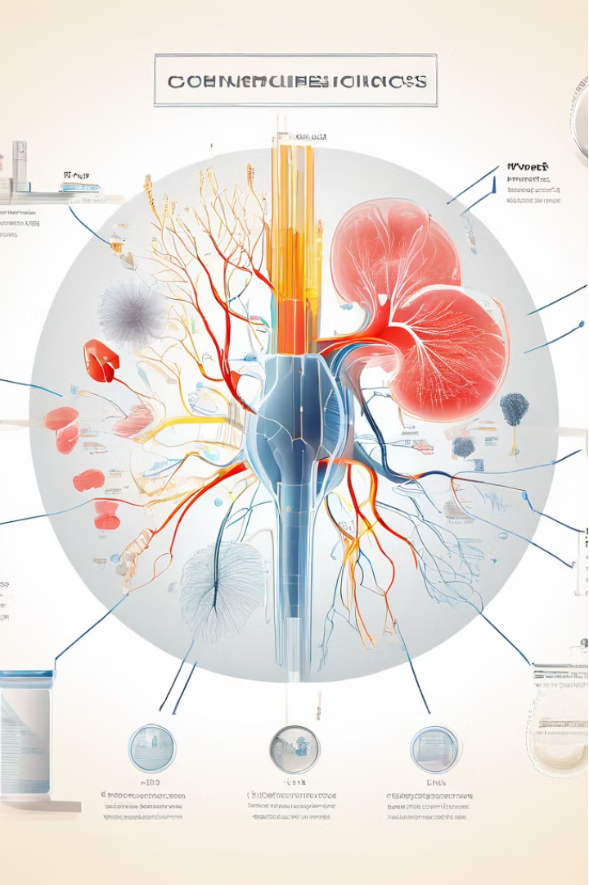
Project Overview
1
Project Name: Chronic Kidney Disease Prediction
Project Guide: Deepak Gurav Sir
Group Members:
-Nachiket Kulkarni
-Chetan Bagul
-Lalit Borase
-Sumit Jagtap

Slide 3
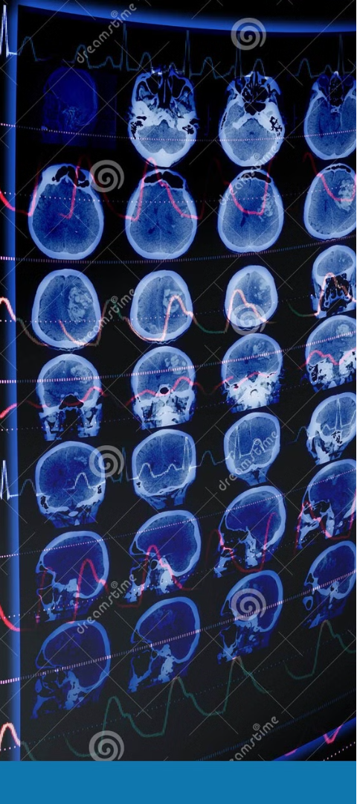
Importance of Early Prediction
Timely Intervention
Improved Outcomes
Early prediction of chronic kidney disease allows for prompt medical intervention, which can help slow disease progression and prevent or delay the onset of complications.
Early detection and management of CKD can significantly improve patient outcomes, reducing the risk of kidney failure, cardiovascular disease, and other related health issues.
Cost Savings
Proactive management of CKD through early prediction can lead to substantial cost savings for healthcare systems by reducing the need for expensive treatments like dialysis or kidney transplants.

Slide 4

Overview of Machine Learning Techniques and Python Libraries
Machine Learning (ML) is a powerful tool for predicting Chronic Kidney Disease (CKD) by identifying patterns in complex medical data.
Popular ML techniques for CKD prediction include Decision Trees, Random Forests, Support Vector Machines, and K-Nearest Neighbors.
Python is a widely-used programming language for ML, with robust libraries like scikit-learn, TensorFlow, and Keras that provide easy-to-use APIs for building and training ML models.

Slide 5
EDA and Different Plotting Techniques Used
Exploratory Data Analysis (EDA)
1
Comprehensive EDA was conducted to gain a deep understanding of the dataset, including identifying patterns, outliers, and relationships between variables.
2
Univariate Analysis
Utilized various plotting techniques such as histograms, box plots, and scatter plots to analyze the distribution and characteristics of individual features.
Multivariate Analysis
3
Explored the interplay between multiple variables through techniques like correlation matrices, pair plots, and heatmaps to uncover hidden insights.

Slide 6
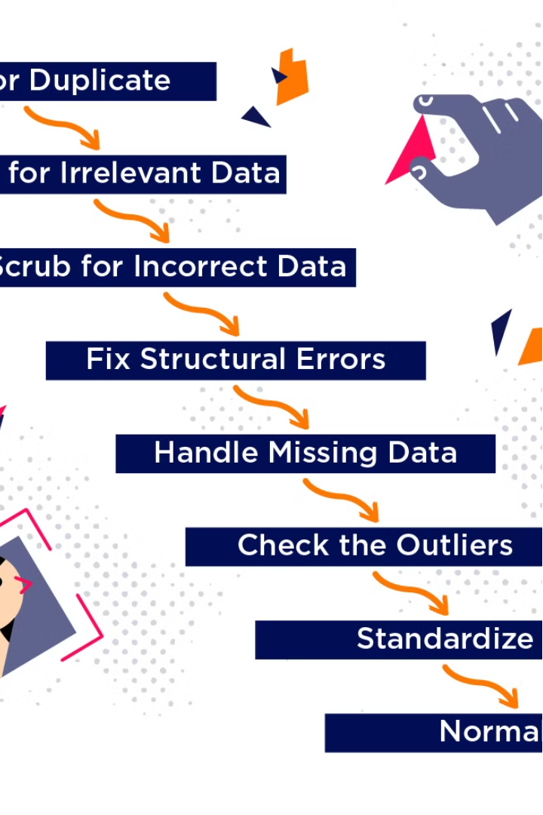
Data Cleaning and Preprocessing
Rigorous data cleaning and preprocessing prepared the dataset for effective machine learning modeling. This involved handling missing values, removing outliers, and transforming variables to ensure high-quality data.
Techniques like imputation, outlier detection, and feature engineering were used to enhance the data's suitability for analysis.

Slide 7
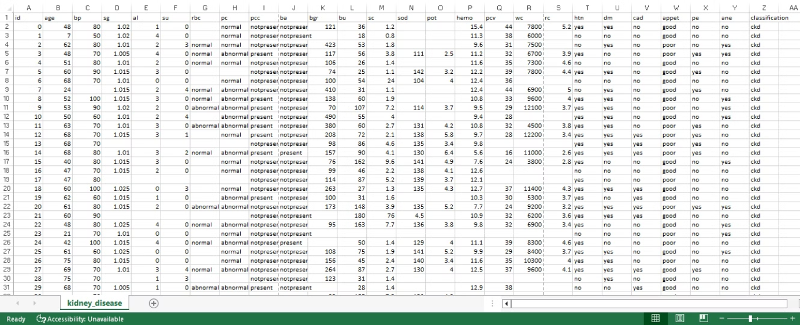
Dataset

Slide 8

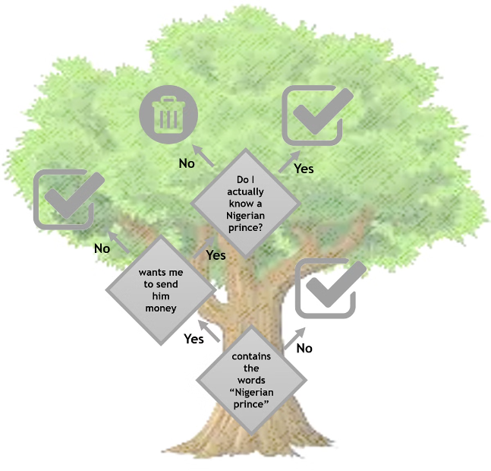
Decision Tree Classifier
The decision tree classifier is a powerful machine learning algorithm well-suited for CKD prediction. It builds a tree-like model of decisions and their possible consequences, allowing for the identification of the most important features in the dataset. This interpretable structure makes decision trees easy to understand and explain, while their flexibility in handling diverse data types makes them a robust choice for complex medical applications.
Key advantages of the decision tree classifier include:
Feature Importance: Identifies the most influential variables in predicting CKD
Interpretability: Provides a visual, easy-to-understand model structure
Flexibility: Handles both numeric and categorical data effectively

Slide 9



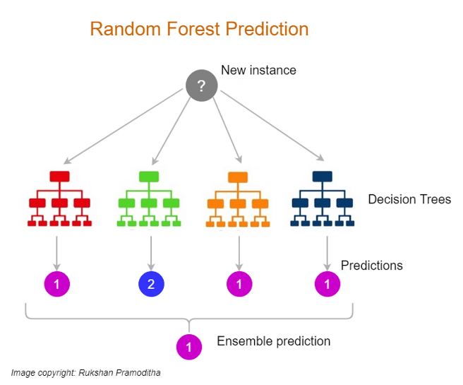
Random Forest Classifier
1
2
3
1
Ensemble Learning
Combines decision trees for enhanced predictive power
2
Feature Importance
Identifies key variables in CKD prediction
3
Robustness
Handles complex data patterns
The random forest algorithm leverages multiple decision trees to make highly accurate CKD predictions. It provides valuable insights on the most influential features.

Slide 10



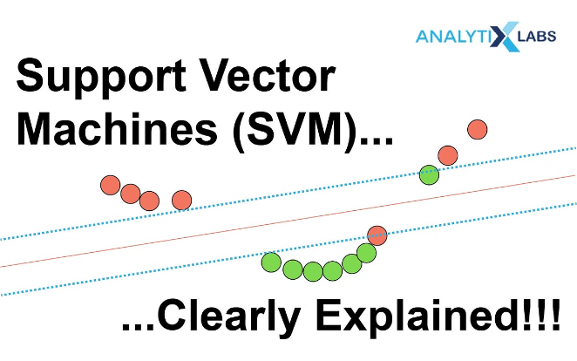
Support Vector Machine Algorithm
1
2
3
1
Optimal Hyperplane
Finds the decision boundary to separate classes
2
Kernel Trick
Enables non-linear classification
3
Margin Maximization
Finds the widest margin between classes
SVM is a powerful technique for CKD prediction, identifying the optimal hyperplane to separate classes and maximize the margin between them. Its kernel trick enables non-linear classification, making it a flexible choice for complex medical data.

Slide 11




K-Nearest Neighbor Algorithm
1
2
3
1
Simple Concept
Classifies new data based on proximity to neighbors.
2
Handles Complexity
Effective for non-linear boundaries in CKD data.
3
Robust Performance
Consistently delivers high accuracy in CKD prediction.
The KNN algorithm is a straightforward yet powerful technique for CKD prediction, classifying new data based on its nearest neighbors.

Slide 12
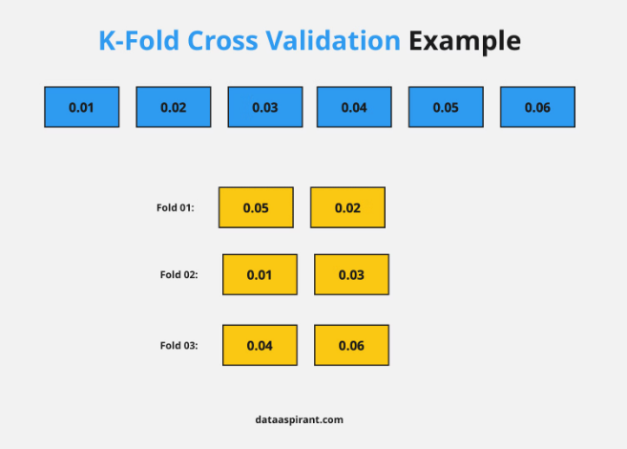
Understanding k-fold Cross Validation
k-fold cross validation is a robust technique to evaluate machine learning models. It splits the dataset into k folds, trains on k-1 and tests on the remaining fold, repeating this process k times.
This approach provides a reliable estimate of model performance by leveraging the entire dataset for both training and testing, reducing the risk of overfitting or underfitting.

Slide 13
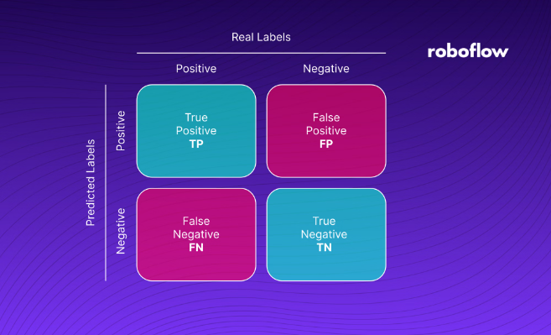
Understanding Confusion Matrices
A confusion matrix is a powerful visualization tool used to evaluate the performance of a classification model. It displays the number of true positives, true negatives, false positives, and false negatives, providing a comprehensive view of how well the model is able to predict the different classes in the dataset. By analyzing the confusion matrix, data scientists can identify areas for improvement and fine-tune the model to achieve higher accuracy.

Slide 14
Thank You!!

